Slide 1

Document Image Analysis Using OCR
Marathwada Mitra Mandal’s
College of Engineering, Pune
Project by Rahul Agrawal[TC202] , TE-Comp , MMCOE
Under Guidance of Dr. Harmeet Khanuja

Slide 2
Introduction
Problem Statement
Literature Review
Methodology
Scope for Social Problem Solution
Software and Hardware Requirements
Objective
Index

Slide 3
Introduction And Motivation
Documents are an important aspect of many enterprises in a variety of sectors, including law, finance, and technology .
So , to increase speed and efficiency , using deep learning and Modern tools ,
we can perform such a operations so that the processing and storage of data will be organised And nearly automated so the time and human work required for this task can be reduced .

Slide 4
Problem-Statement
Classify the document and recognize meaningful components from documents .
serve the document data to another service and store in database for future use.

Slide 5

Objective
Develop the Product to help the society, businesses to reduce human efforts
Maintain and secure the confidential documents in databases with best practices
Serve the data to other applications using API

Slide 6
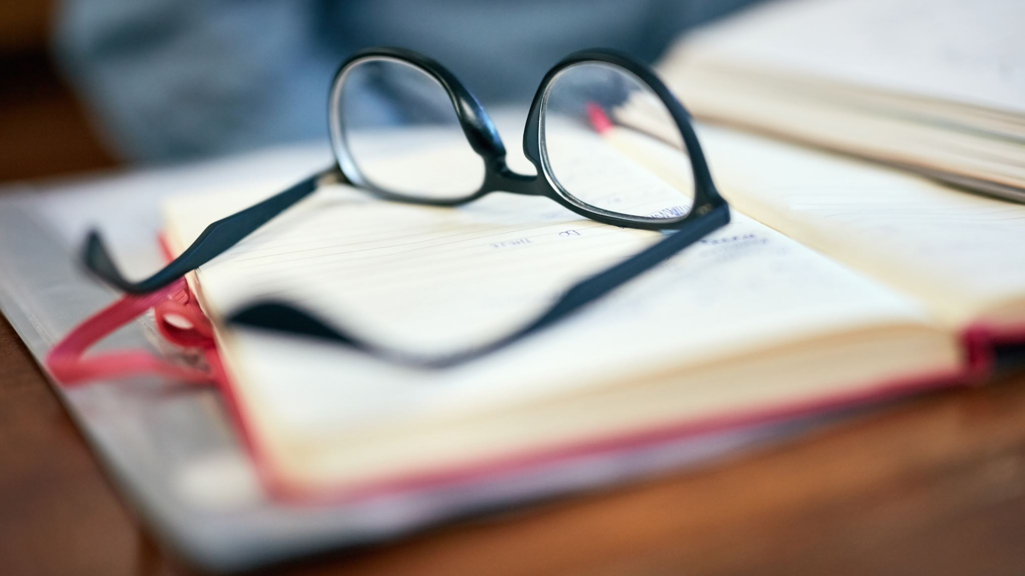
Literature Review

Slide 7
Journal Titles | Highlights | Authors
Handwritten Optical Character Recognition (OCR) | 1] Trends in OCR through the world by different researchers and their findings 2] model training for STRUCTURAL PATTERN RECOGNITION 3] preserve about to extinct languages using structural recognition | 1] JAMSHED MEMON 2] MAIRA SAMI 3]RIZWAN AHMED KHAN 4]MUEEN UDDIN
Optical Character Recognition by Open-Source OCR Tool Tesseract | 1] history and architecture of open source Library “TESSERACT” 2] working and algorithms behind tesseract | Chirag Indravadanbhai Patel and Dharmendra Patel
An Overview of the Tesseract OCR Engine | 1] Architecture and classification methods behind working of tesseract 2] Line and Word recognition from images | Ray Smith
Text Recognition and Medicine Identification by Visually Impaired People | 1] Architecture and classification methods behind working of tesseract 2] Line and Word recognition from images | Snigdha Kesh, Ananthanagu U
Published Year
August ,2020
October,2017
July 2019
May,2018

Slide 8
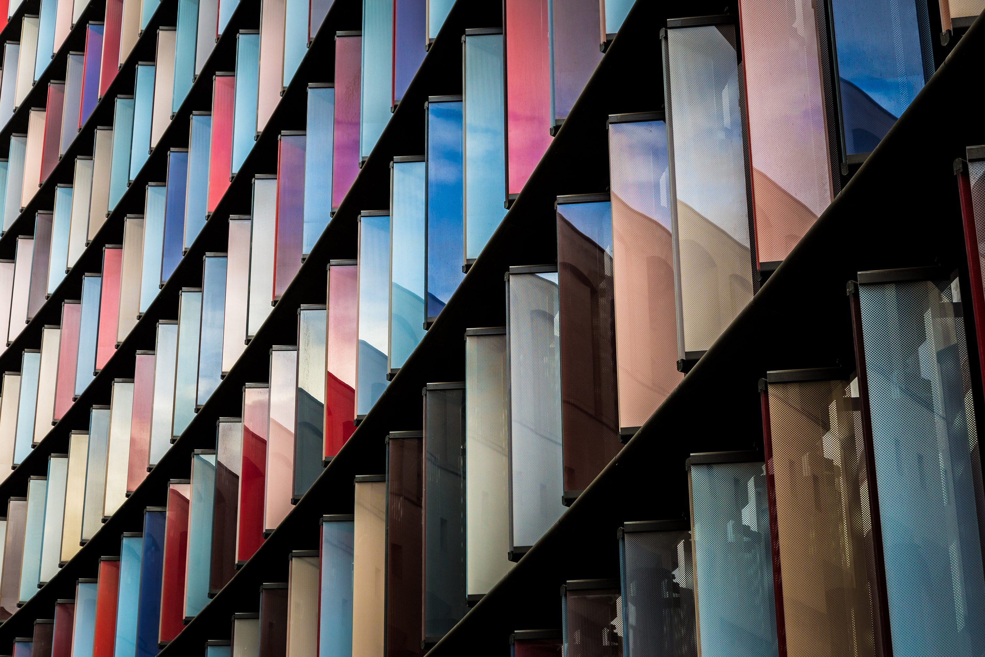
Handwritten Optical Character Recognition (OCR): A Comprehensive Systematic Literature Review (SLR)
Published in IEEE-International Conference by
1] JAMSHED MEMON 2] MAIRA SAMI
3]RIZWAN AHMED KHAN 4]MUEEN UDDIN
on August 14, 2020.
Overview
1] Trends in OCR through the world by different researchers and their findings
2] model training for STRUCTURAL PATTERN RECOGNITION
3] preserve about to extinct languages using structural recognition
https://ieeexplore.ieee.org/stamp/stamp.jsp?tp=&arnumber=9151144

Slide 9
Optical Character Recognition by Open Source OCR Tool Tesseract
Published
in International Journal of Computer Applications · October 2017
By
Chirag Indravadanbhai Patel and Dharmendra Patel
Overview
1] history and architecture of open source Library “TESSERACT”
2] working and algorithms behind tesseract
https://www.researchgate.net/publication/235956427_Optical_Character_Recognition_by_Open_source_OCR_Tool_Tesseract_A_Case_Study/link/00463516fa43a64739000000/download

Slide 10
An Overview of the Tesseract OCR Engine
Published in Google research by
Ray Smith , developer at Tesseract OCR engine at HPLabs Bristol for 10 years
Overview
1] Architecture and classification methods behind working of tesseract
2] Line and Word recognition from images
https://static.googleusercontent.com/media/research.google.com/en//pubs/archive/33418.pdf

Slide 11

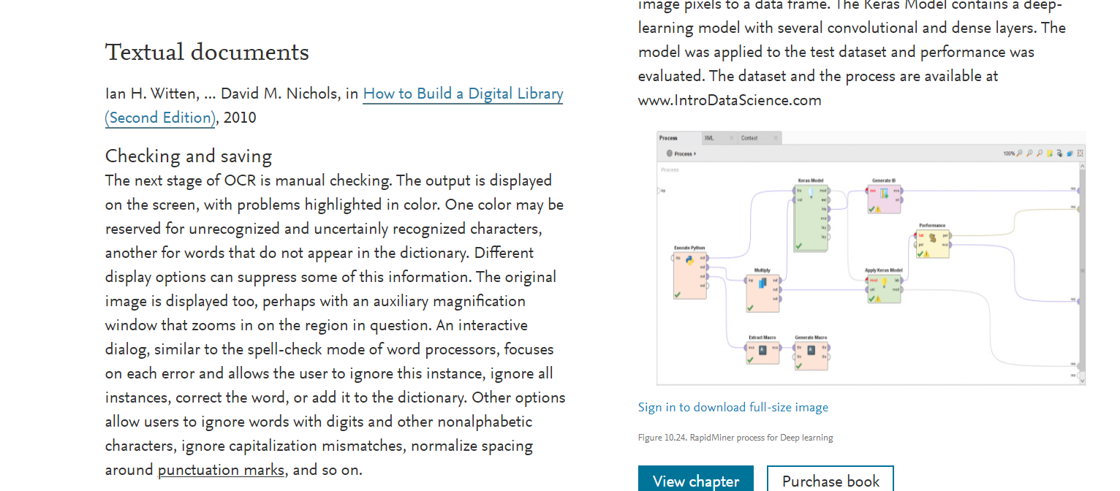
complate overview article on OCR by sciencedirect.com
Highlights
research and findings on OCR throughout History
detailed architecture of model from various authors
working explained with mathematical proofs
A Image from an article
https://www.sciencedirect.com/topics/computer-science/optical-character-recognition

Slide 12
Text Recognition and Medicine Identification by Visually Impaired People
published in International Journal of Engineering Research & Technology (IJERT)
By Snigdha Kesh, Ananthanagu U
About Project
Mobile inbuild camera start capturing image and application will extract text from scene image then application will again convert text data to voice message. To identify medicine Visually impaired people shake phone, camera will on and take medicine image convert to text and send to server, server will match with store data., give voice alert to the blind person. Using this application, they will never miss medicine and no need third person help
https://www.ijert.org/research/text-recognition-and-medicine-identification-by-visually-impaired-people

Slide 13

Methodology

Slide 14
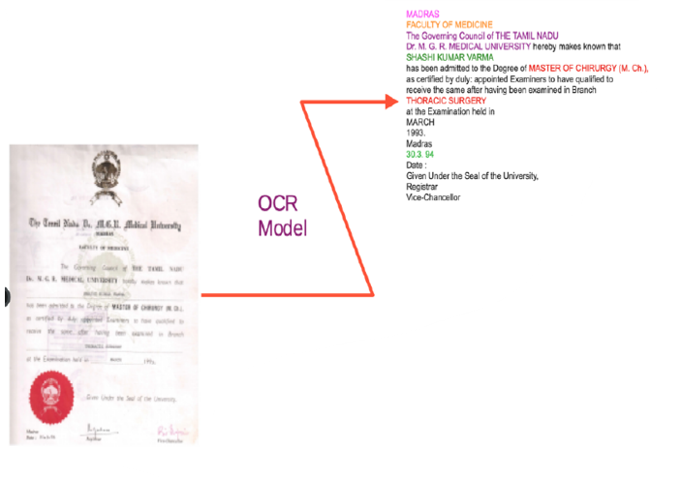
Perform Image Enhancing and apply OCR techniques To retrieve text from Image

Slide 15
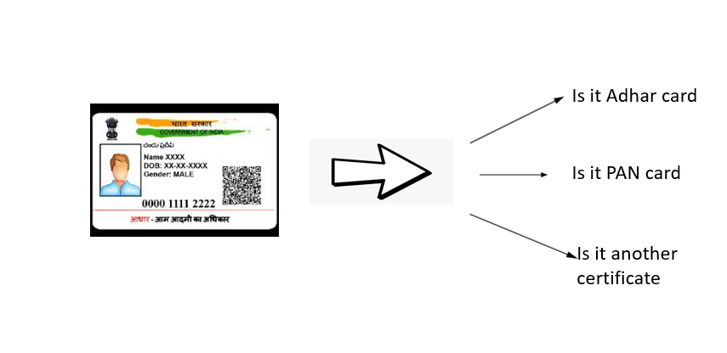
Classify the image Using NLP on Extracted Text into documents like certificates, ID (Driving license, AADHAR Card, PAN Card)
NLP Based Classification

Slide 16

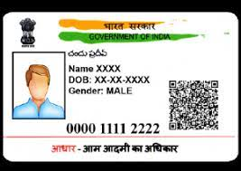

Gather all the Useful information From text and serve it as JSON
{
"Document-Type": " adhar", "Name":"Rahul Sunil Agrawal",
"Gender": "Male",
"Birth year": "2002",
"Unique-ID": “0000-1111-2222"
}

Slide 17

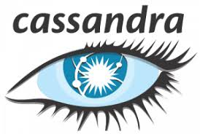

Maintain a Database for Future use

Slide 18
Hardware Requirements
Computer with following At least Components
64 bit Motherboard greater than 7th Generation
4GB RAM
128 ROM (SSD Preferable)
Webcam for Capturing Image
GPU for faster performance (not mandatory)

Slide 19

Software Requirements
Python 3.5 or grater
OpenCV-python > v.4.0
Flask > v.1.0
Pytesseract
Tesseract
EasyOCR
Keras with TensorFlow as Backend
Database Server like MySQL , MongoDB etc.

Slide 20

Scope for Social Problem Solution

Slide 21

Business
boost up resume analysis to classify candidates
Maintain employee’s id database
Maintain old records that are on paper

Slide 22

Educational Institutions
Process and maintain the student data like adhar card , certificates , bank passbook etc.
Increase availability of library books by converting to computer readable format

Slide 23
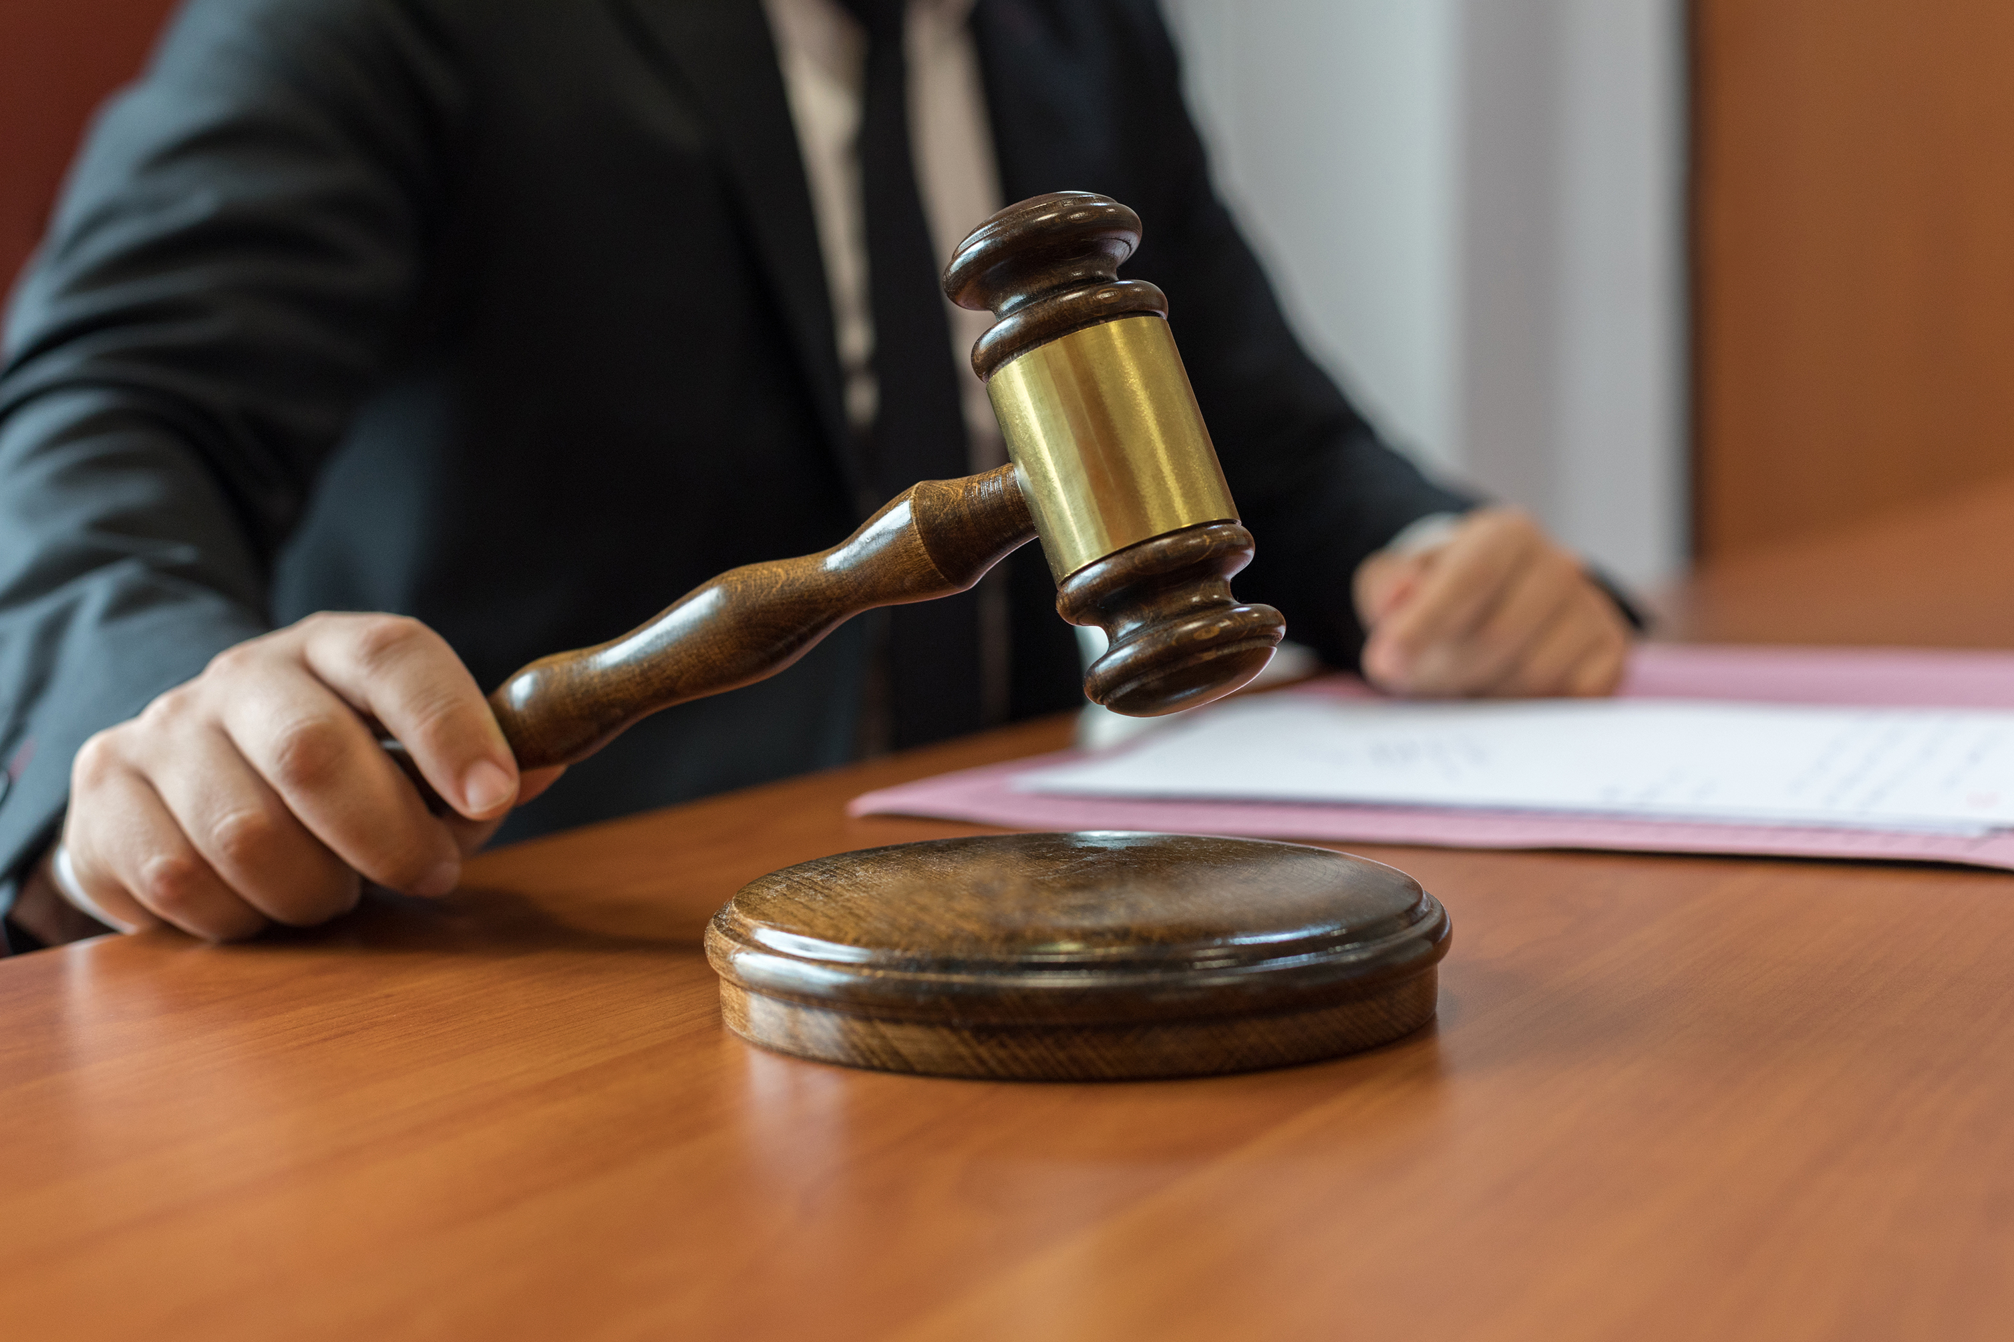
Judiciary and Law Enforcement Agencies
Storing old documents in computer to avoid loss and privacy
Developing application to easily verify documents
Maintain records of documents such as stamp papers

Slide 24

Thank You

